Slide 1
FIR Filter Design
Chapter Intended Learning Outcomes:
(i) Understanding of the characteristics of linear-phase finite
impulse response (FIR) filters
(ii) Ability to design linear-phase FIR filters according to
predefined specifications using the window and frequency
sampling methods
Y.Chen
Page 1
Semester A 2022-2023

Slide 2








Steps in Digital Filter Design
1. Specification Determination
The first step is to obtain the filter specifications or
requirements which are determined by the applications.
Suppose we have observations
where is
the signal of interest and is the additive noise. The
only has low-frequency components such that
for
for the
while is of wideband such that
whole frequency range.
If our task is to find from , we can use a lowpass
filter with cutoff frequency of to obtain a noise-reduced
version of .
Y.Chen
Page 2
Semester A 2022-2023

Slide 3
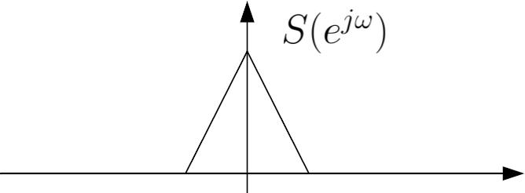
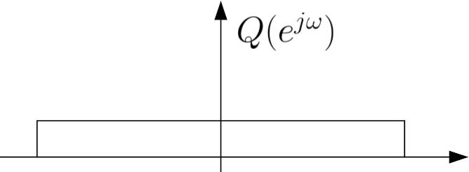



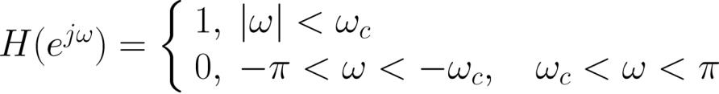
Fig.10.1: Spectra of signal and noise
The filter specification can be described by discrete-time
Fourier transform (DTFT)
:
(10.1)
which specifies both the magnitude and phase
Y.Chen
Page 3
Semester A 2022-2023

Slide 4
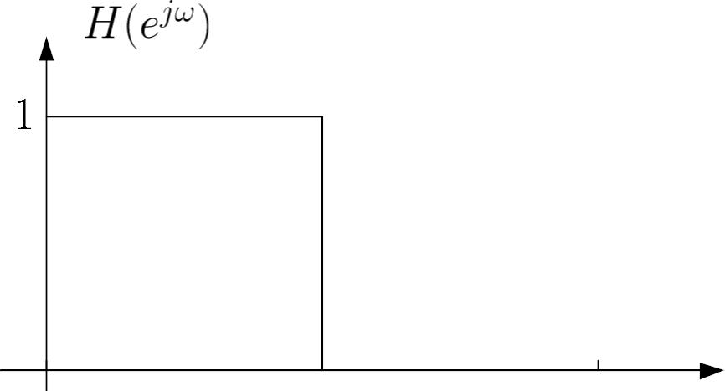




Fig.10.2: Ideal lowpass filter
. unity gain for the whole range of
. complete suppression for
. step change in frequency response at
Y.Chen
Page 4
Semester A 2022-2023

Slide 5
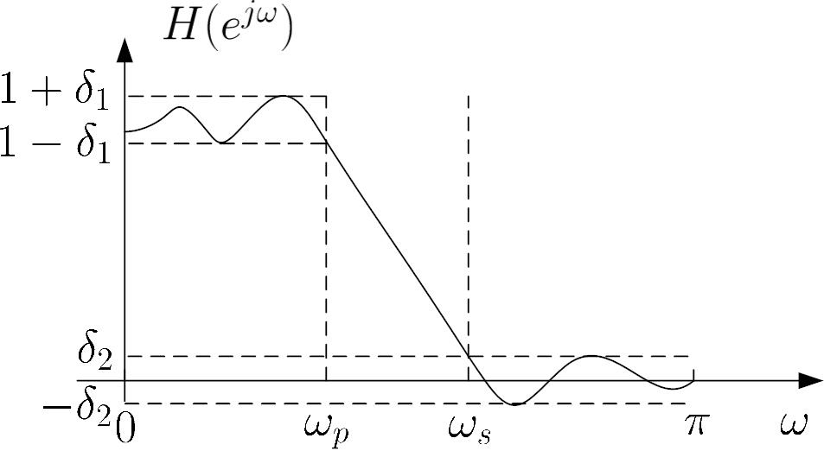




passband
transition
stopband
Fig.10.3: Practical
. passband corresponds to
passband frequency and
where
is the
is the passband ripple or
tolerance which is the maximum allowable deviation from
unity in this band
Y.Chen
Page 5
Semester A 2022-2023

Slide 6






. stopband corresponds to
where
is the
stopband frequency and
is the stopband ripple or
tolerance which is the maximum allowable deviation from
zero in this band
. transition band corresponds to
where there are
no restrictions on
in this band
2. Filter Response Calculation
We then use digital signal processing techniques to obtain a
filter description in terms of transfer function or
impulse response
that fulfills the given specifications
3. Implementation
When
or
are known, the filter can then be realized
in hardware or software according to a given structure
Y.Chen
Page 6
Semester A 2022-2023

Slide 7

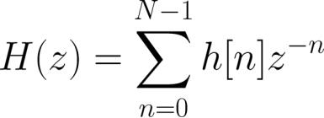

Advantages of FIR Filter
Transfer function of a causal FIR filter
with length is:
(10.2)
where
is the finite-duration impulse response
. Phase response can be exactly linear which results in
computation reduction and zero phase distortion. Note
that when there is phase distortion, different frequency
components of a signal will undergo different delays in the
filtering process
. It is always stable because
for finite
. Less sensitive to finite word-length effects
Y.Chen
Page 7
Semester A 2022-2023

Slide 8


. Efficient implementation via digital signal processors with
multiply-and-add (MAC) instruction
. Existence of optimality theorem for FIR filter design
Linear-Phase FIR Filter
The phase response of a linear-phase filter is a linear
function of the frequency :
(10.3)
where equals 0 or
of the filter length.
and is a constant which is function
Note that (10.3) is slightly different from that in previous
chapters where the phase response complements with the
magnitude response
.
Y.Chen
Page 8
Semester A 2022-2023

Slide 9





Here, the phase response is related to
by
(10.4)
is real and is called the amplitude response.
where
Comparing
(10.5)
is
where
is nonnegative, we see that when
positive, the phase responses in (10.4) and (10.5) are
identical but there is a phase difference of for a negative
.
Y.Chen
Page 9
Semester A 2022-2023

Slide 10


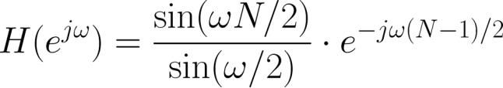
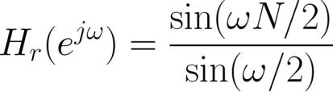
Example 10.1
Determine the amplitude response and the corresponding
phase response for a FIR filter with impulse response :
Plot the spectra for
. Compare the results with the
magnitude response and the corresponding phase response.
Using Example 6.2:
Hence the amplitude response is
Y.Chen
Page 10
Semester A 2022-2023

Slide 11

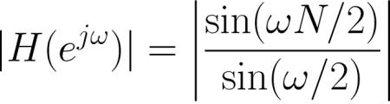
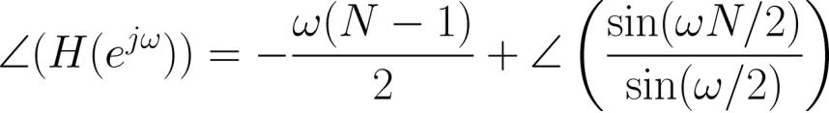
and the corresponding phase response is
On the other hand, the magnitude response and the
corresponding phase response are:
and
The MATLAB program is provided as ex10_1.m.
Y.Chen
Page 11
Semester A 2022-2023

Slide 12
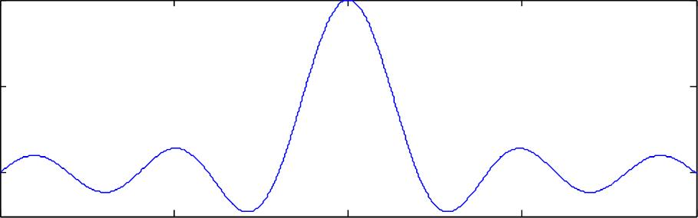
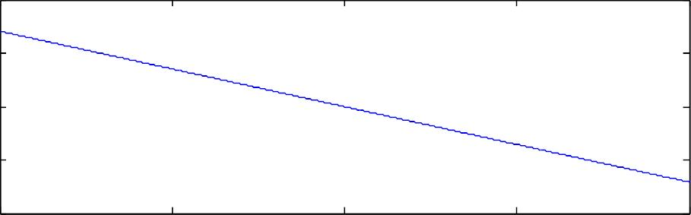
Amplitude R esponse
10
5
0
-1
-0.5
0
/
0.5
1
Phase Response
20
10
0
-10
-20
-1
-0.5
0
0.5
1
/
Fig.10.4: Amplitude and phase spectra
Y.Chen
Page 12
Semester A 2022-2023

Slide 13
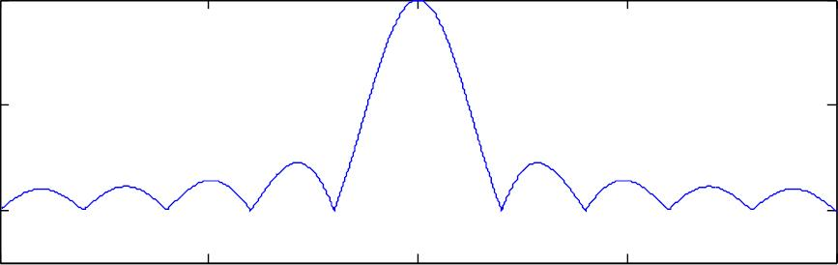
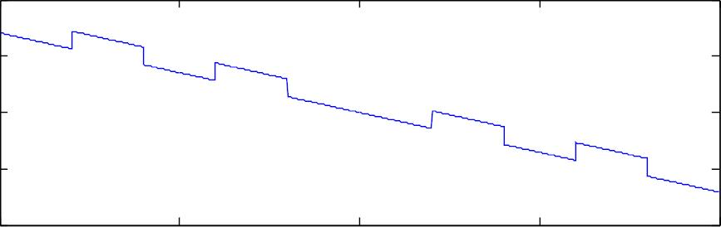
Magnitude Response
10
5
0
-1
-0.5
0
/
0.5
1
Phase Response
20
10
0
-10
-20
-1
-0.5
0
0.5
1
/
Fig.10.5: Magnitude and phase spectra
Y.Chen
Page 13
Semester A 2022-2023

Slide 14




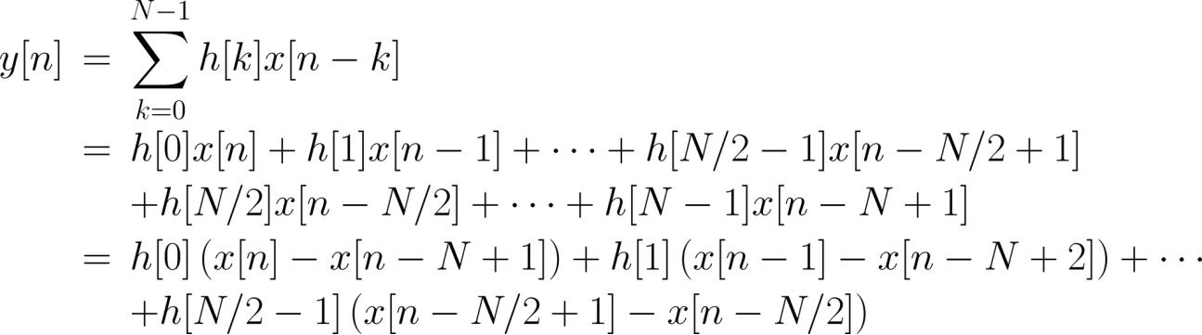
For a causal linear-phase FIR filter, the impulse response
is either symmetric or anti-symmetric:
(10.6)
or
(10.7)
For example, when is even in (10.7):
,
,
(10.8)
Y.Chen
Page 14
Semester A 2022-2023

Slide 15
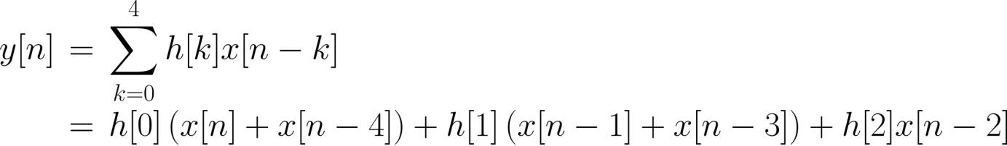
How many multipliers and additions are needed?
Example 10.2
Draw the block diagram using the direct form with minimum
number of multiplications for the FIR filter whose impulse
response is:
Following (10.8), we obtain:
The number of multiplications is reduced from to while
the number of additions remains unchanged, which is 4.
Y.Chen
Page 15
Semester A 2022-2023

Slide 16

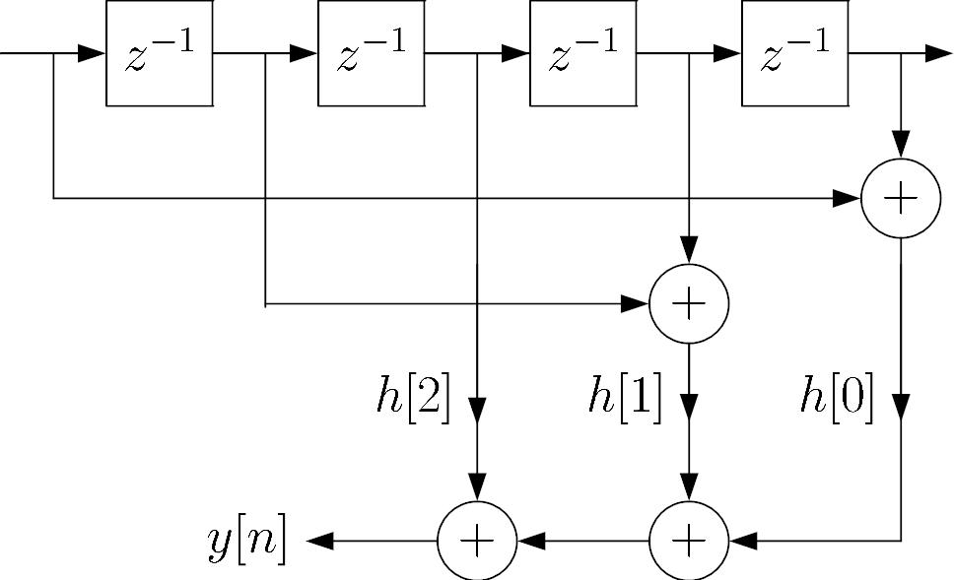

Fig.10.6: Block diagram for symmetric impulse response
Y.Chen
Page 16
Semester A 2022-2023

Slide 17
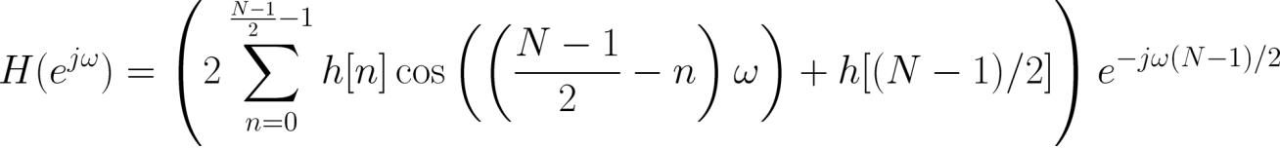


There are four types of linear-phase FIR filters:
1. Symmetric Impulse Response with Odd
Taking the DTFT of
yields
(10.9)
where
and
is an integer.
Y.Chen
Page 17
Semester A 2022-2023

Slide 18




Example 10.3
The impulse response
of a causal FIR filter satisfies
,
with is odd. Show that
According to (10.6) with odd , we have
Y.Chen
Page 18
Semester A 2022-2023

Slide 19
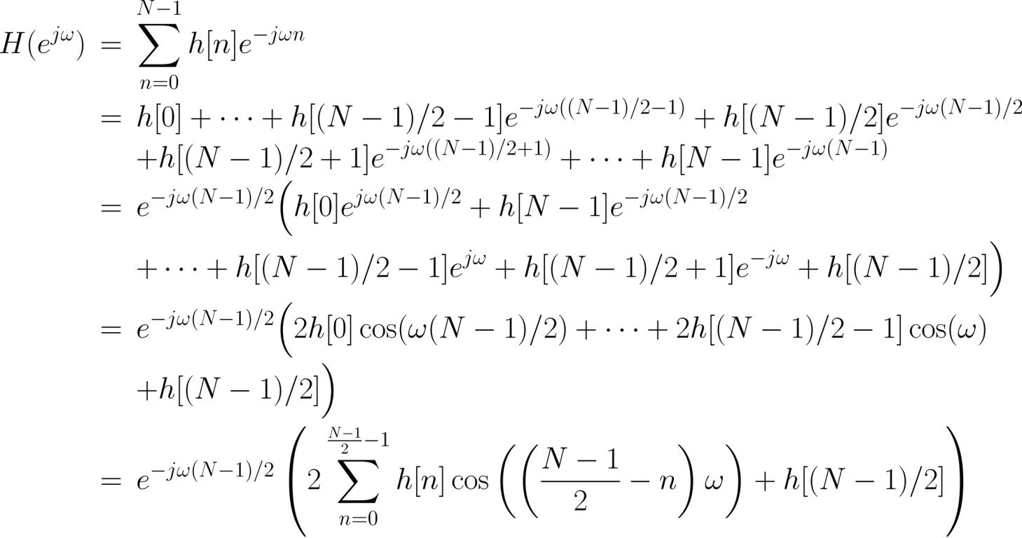
Hence
Y.Chen
Page 19
Semester A 2022-2023

Slide 20

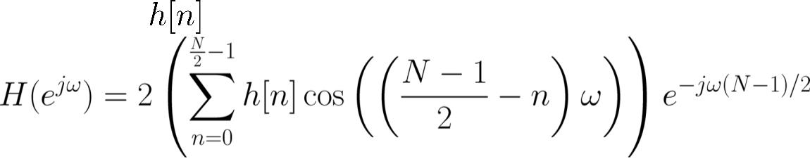
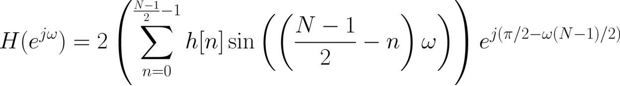
which validates (10.9) with
.
2. Symmetric Impulse Response with Even
The DTFT of
is:
(10.10)
where
and
is not an integer.
3. Anti-symmetric Impulse Response with Odd
The DTFT of
is:
(10.11)
Y.Chen
Page 20
Semester A 2022-2023

Slide 21



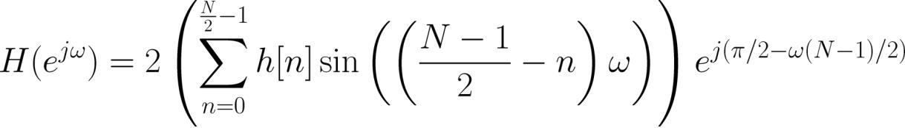
where
and
is an integer
Note that
due to anti-symmetric property
4. Anti-symmetric Impulse Response with Even
Taking the DTFT of yields:
(10.12)
where
and
is not an integer.
Y.Chen
Page 21
Semester A 2022-2023

Slide 22











Example 10.4
Consider an input sequence
of length 400 such that
, and it is a sinusoid
for
and
with frequencies
and
for
and
, respectively.
Examine the filter output
systems:
with the following two FIR
(a)
(b)
with
with
Are they linear phase filters?
The MATLAB program for this example is provided as
Y.Chen
Page 22
Semester A 2022-2023

Slide 23
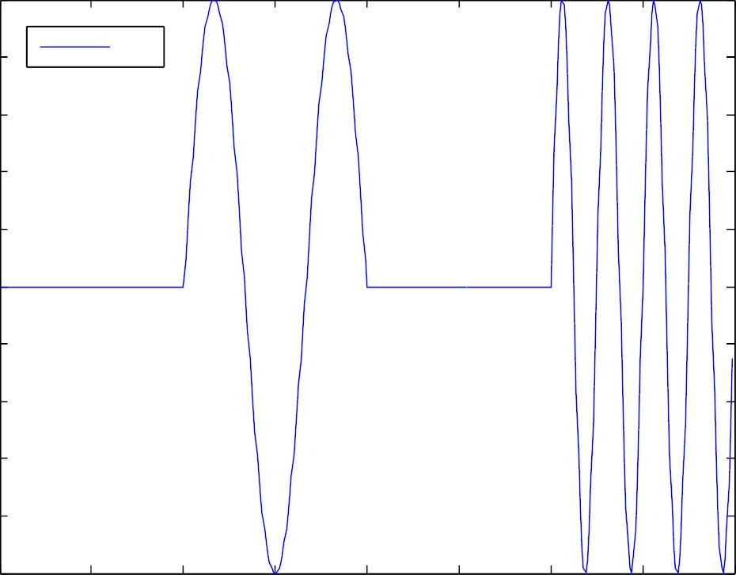
ex10_4.m.
1
0.8
0.6
0.4
0.2
0
x[ n]
-0.2
-0.4
-0.6
-0.8
-1
0
50
100
150
200
n
250
300
350
400
Y.Chen
Page 23
Semester A 2022-2023

Slide 24
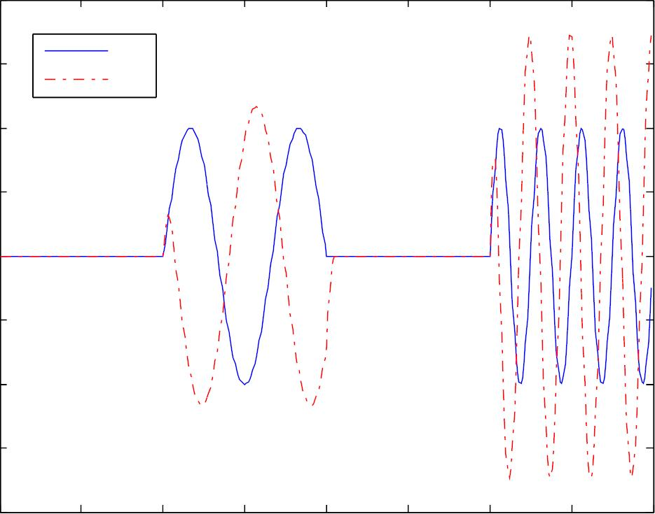
Fig.10.7: Pulsed sinusoid with two frequencies
2
1.5
1
x[ n]
y[ n]
0.5
0
-0.5
-1
-1.5
-2
0
50
100
150
200
n
250
300
350
400
Y.Chen
Page 24
Semester A 2022-2023

Slide 25
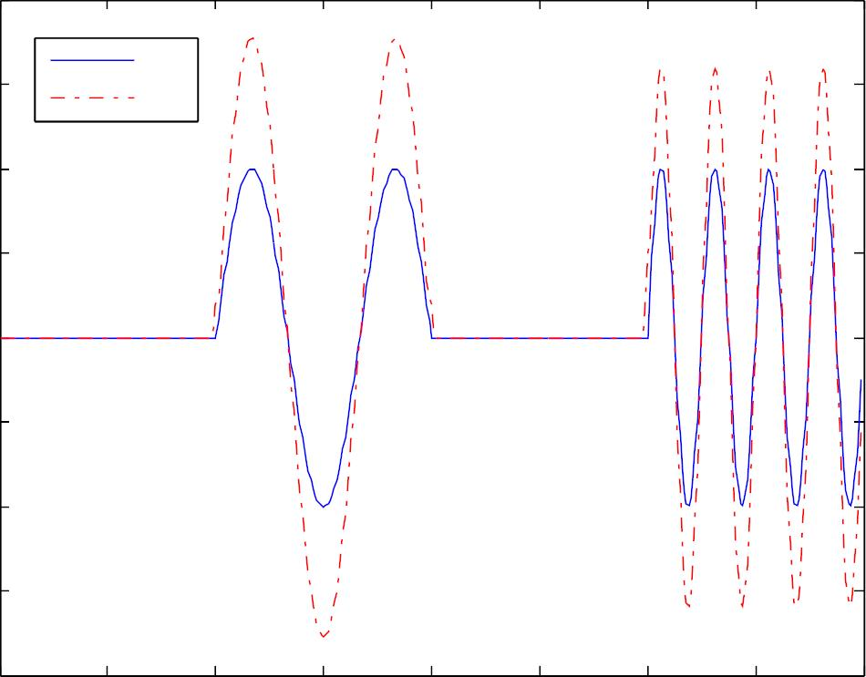
Fig.10.8: Filter output with nonlinear-phase filter
2
x[ n]
y[ n]
1.5
1
0.5
0
-0.5
-1
-1.5
-2
0
50
100
150
200
n
250
300
350
400
Y.Chen
Page 25
Semester A 2022-2023

Slide 26




Fig.10.9: Filter output with linear-phase filter
Example 10.5
The impulse response of a causal linear-phase FIR
is:
where
. Determine
. Plot the amplitude and
phase responses and then deduce the function of the filter.
Find the expected filter output
sequence of the form
when passing an input
through the filter.
As
is odd and
is anti-symmetric, we apply (10.11):
Y.Chen
Page 26
Semester A 2022-2023

Slide 27
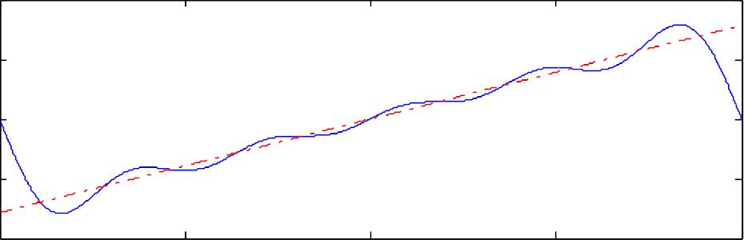
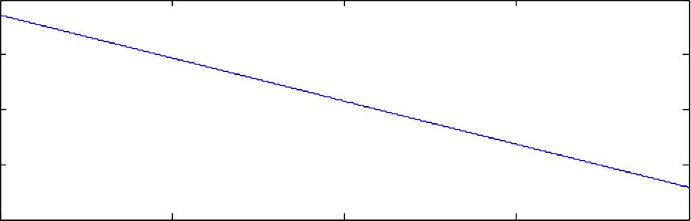
Amplitude R esponse
4
2
0
-2
-4
-1
-0.5
0
/
0.5
1
Phase Response
20
10
0
-10
-20
-1
-0.5
0
0.5
1
/
Y.Chen
Page 27
Semester A 2022-2023

Slide 28
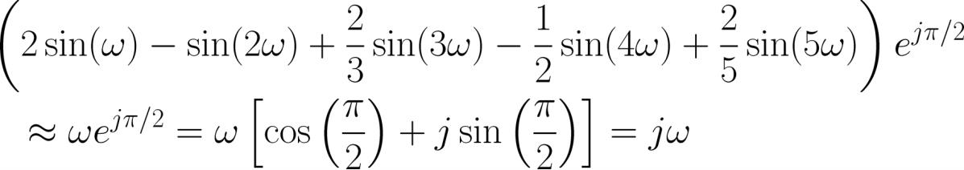

Fig.10.10: Amplitude and phase responses of differentiator
The amplitude response can be approximated as:
According to the time-shifting property, the DTFT of with
a time advance of 5 samples is then:
This means that the causal FIR filter has a frequency
response approximately equals
with a delay of 5
Y.Chen
Page 28
Semester A 2022-2023

Slide 29

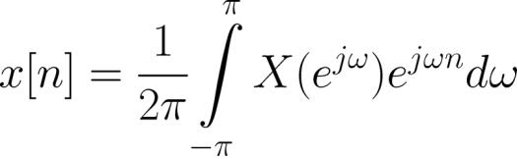
samples.
The system with frequency response is known as the
differentiator. Recall:
Differentiating both sides with respect to yields:
Y.Chen
Page 29
Semester A 2022-2023

Slide 30
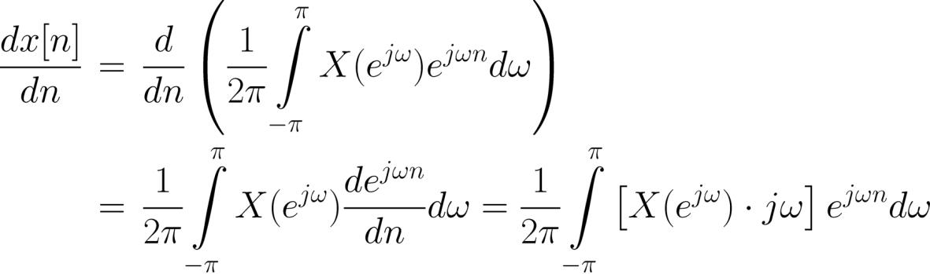
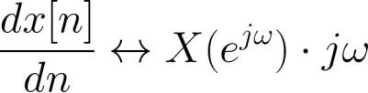
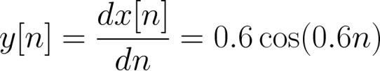
which confirms:
As a result, we expect the output is close to:
Y.Chen
Page 30
Semester A 2022-2023

Slide 31
with a delay of 5 samples
The MATLAB program is provided as ex10_5.m.
Y.Chen
Page 31
Semester A 2022-2023

Slide 32
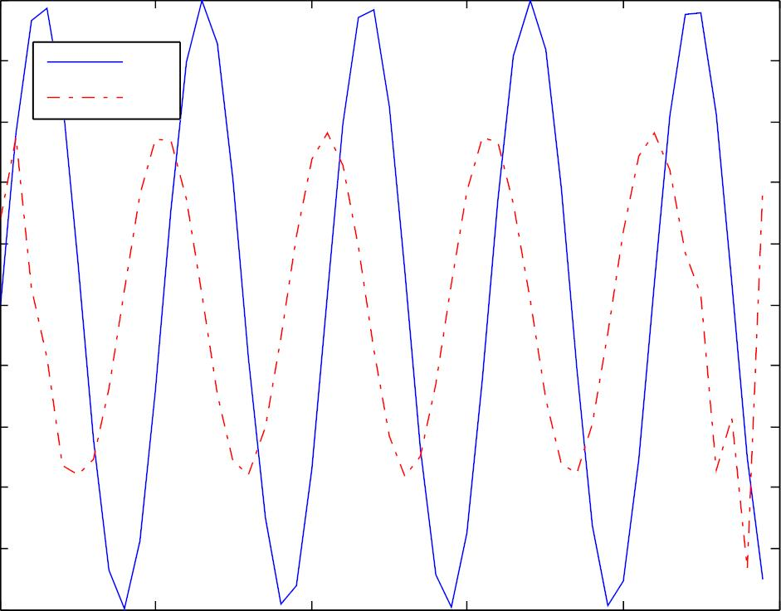
1
0.8
0.6
0.4
0.2
0
x[ n]
y[ n]
-0.2
-0.4
-0.6
-0.8
-1
0
10
20
30
40
50
n
Fig.10.11: Differentiator output with sinusoidal input
Y.Chen
Page 32
Semester A 2022-2023

Slide 33


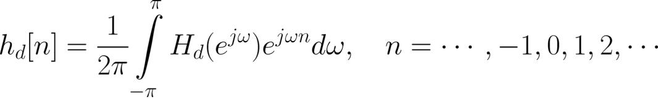
Window Method
Based on directly approximating the desired frequency
response
Ideal impulse response
is calculated from inverse DTFT:
(10.13)
What are the problems in using (10.13)?
Y.Chen
Page 33
Semester A 2022-2023

Slide 34

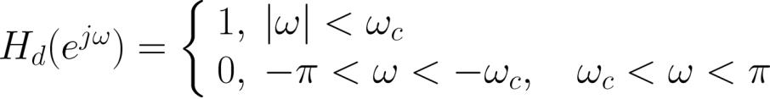

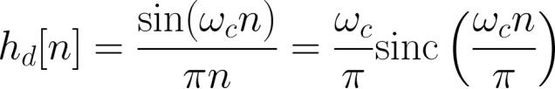
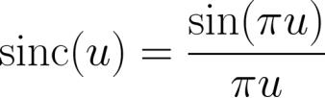
Example 10.6
Determine the impulse response
of an ideal lowpass
filter with a cutoff frequency of . The DTFT of the filter is:
Using Example 6.3,
where
is:
Ideal filter is noncausal and its impulse response is of
Y.Chen
Page 34
Semester A 2022-2023

Slide 35








infinite length
The basic idea of window method is to truncate
to
obtain a linear-phase and causal FIR filter via 2 steps:
. Windowing
. Extract a finite set of
indexes because the impulse response is generally
symmetric or anti-symmetric around , say, {
} corresponding to a length of
with positive and negative time
,
. Filter response is linear phase but is only an
approximation of
. Time Shifting
. Delay
due to the coefficient truncation
by
samples to
obtain
with
to achieve causality
Y.Chen
Page 35
Semester A 2022-2023

Slide 36

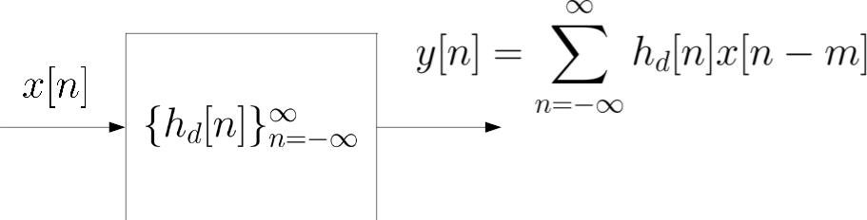
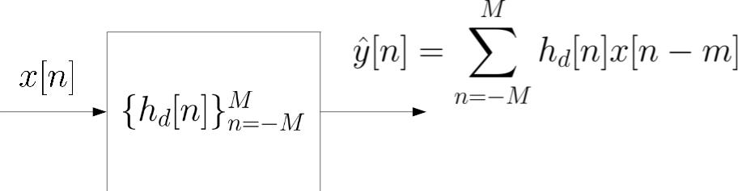
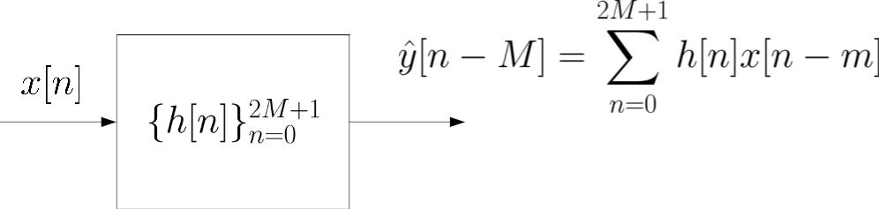
. Filter output is received after a delay of samples
ideal
with
windowing
further with
time shift
Y.Chen
Page 36
Semester A 2022-2023

Slide 37

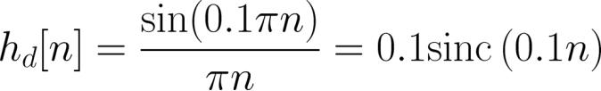

Fig.10.12: Illustration of window method
Example 10.7
Use the window method to design a linear-phase and causal
FIR system with 7 coefficients to approximate an ideal
lowpass filter whose cutoff frequency is
.
From Example 10.6:
Via windowing, we extract the set of
.
.
Notice that
is symmetric around at
as
Their values are calculated as:
Y.Chen
Page 37
Semester A 2022-2023

Slide 38
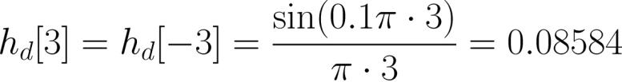
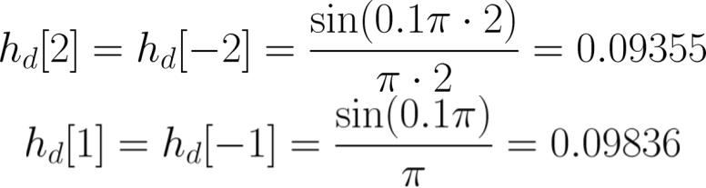
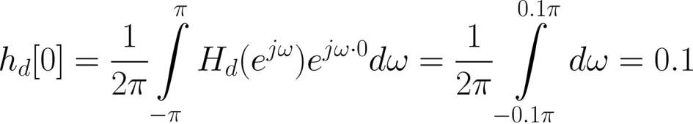
Via time-shifting of 3 samples, a causal filter is obtained as:
:
or
Y.Chen
Page 38
Semester A 2022-2023

Slide 39

with
.
Y.Chen
Page 39
Semester A 2022-2023

Slide 40
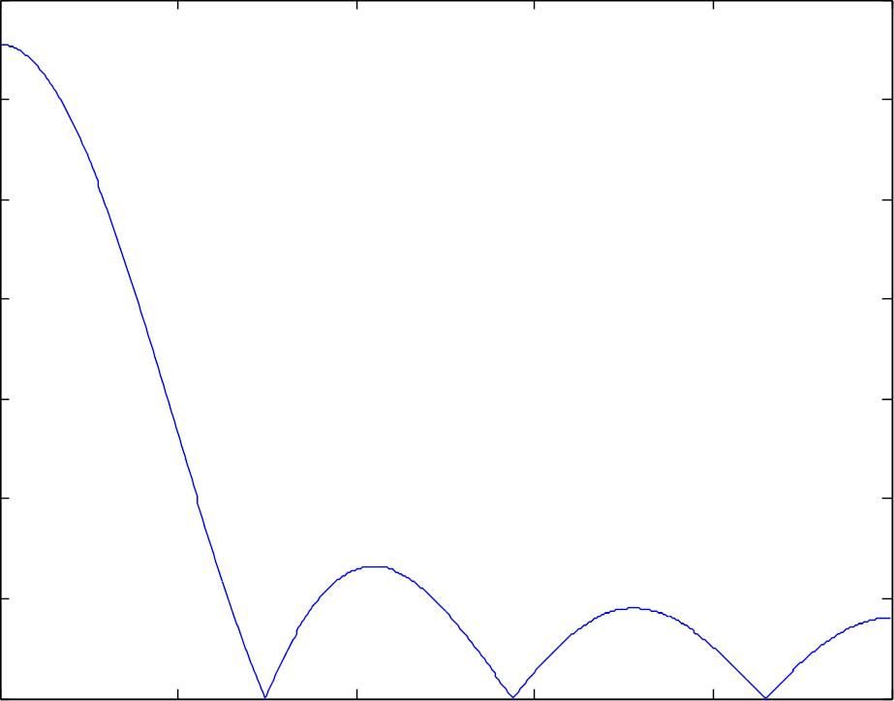

Magnitude Response
0.7
0.6
0.5
0.4
0.3
0.2
0.1
0
0
0.2
0.4
0.6
0.8
1
/
Fig.10.13: Magnitude response of lowpass filter with
Y.Chen
Page 40
Semester A 2022-2023

Slide 41
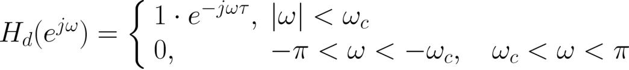

Note that we can use the MATLAB command
fir1(6,0.1,boxcar(7),'noscale') to produce
Alternatively, we can first perform the time shifting prior to
windowing
As there should be a phase of
where
in the
practical filter, we modify the desired frequency response as:
Note that multiplying
in the frequency domain
corresponds to a time shift of in the time domain.
Y.Chen
Page 41
Semester A 2022-2023

Slide 42
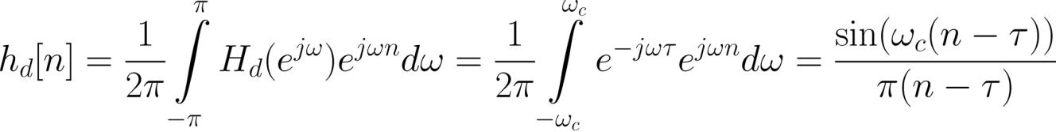

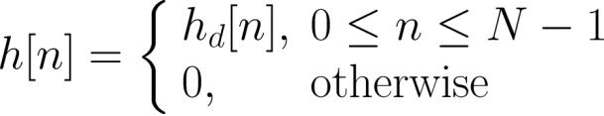

The corresponding impulse response is
As the filter length is , we then perform windowing on
:
Substituting
response.
and
yields the same FIR impulse
Note that we can base on this approach to determine
Y.Chen
Page 42
Semester A 2022-2023

Slide 43
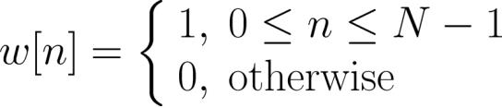


even when is an even integer
The truncation operation can be considered as multiplying
by a rectangular window function:
That is,
Generally speaking,
is not restricted to be rectangular
and it can be any symmetric function so that the resultant
filter is linear phase
Y.Chen
Page 43
Semester A 2022-2023

Slide 44

Example 10.8
Use the window method to design a linear-phase and causal
FIR filter of length 101 such that the sampled version of a
continuous-time sinusoid with frequency of 80 Hz can pass
through it with negligible attenuation while the sampled
signal corresponds to a tone of frequency 120 Hz will be
suppressed. The sampling frequency is 1000 Hz.
Let the continuous-time sinusoids be
From (4.1), the corresponding discrete-time versions with
sampling interval of
s are
Y.Chen
Page 44
Semester A 2022-2023

Slide 45










which gives:
and
The frequencies are
In order to suppress
and
in discrete-time domain.
while keeping , we can use a
, which is
simply the average of the two discrete frequencies.
lowpass filter with cutoff frequency of
Using Example 10.7 with
filter impulse response
and
, the required
is:
Y.Chen
Page 45
Semester A 2022-2023

Slide 46
Y.Chen
Page 46
Semester A 2022-2023

Slide 47
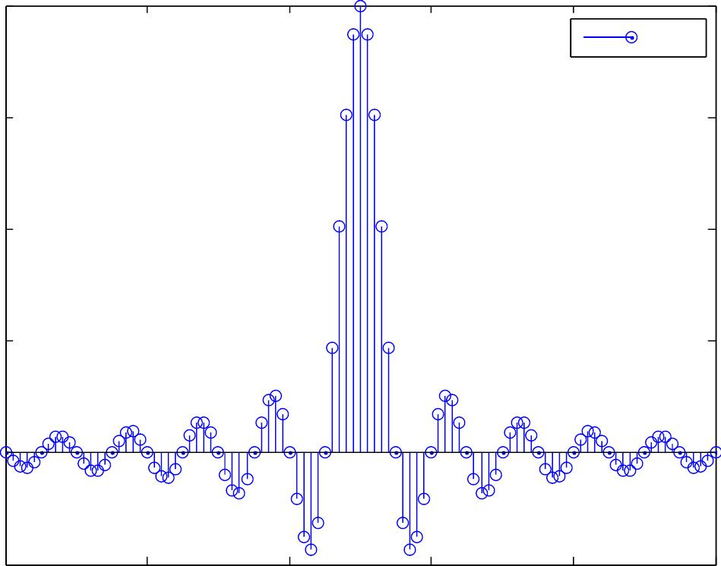

0.2
0. 15
0.1
h[ n]
0. 05
0
-0.05
0
20
40
60
80
100
n
Fig.10.14: Impulse response of lowpass filter with
Y.Chen
Page 47
Semester A 2022-2023

Slide 48


Magnitude Response
1
0.8
0.6
0.4
0.2
0
0
0.2
0.4
0.6
0.8
1
/
Fig.10.15: Magnitude response of lowpass filter with
Y.Chen
Page 48
Semester A 2022-2023

Slide 49

1
0.8
0.6
0.4
0.2
0
s₁[n]
-0.2
-0.4
-0.6
-0.8
-1
100
120
140
160
180
200
n
Fig.10.16: Discrete-time tone with frequency
Y.Chen
Page 49
Semester A 2022-2023

Slide 50

1
0.8
0.6
0.4
0.2
0
s₂[n]
-0.2
-0.4
-0.6
-0.8
-1
100
120
140
160
180
200
n
Fig.10.17: Discrete-time tone with frequency
Y.Chen
Page 50
Semester A 2022-2023

Slide 51

1
0.8
0.6
0.4
0.2
0
filtered s₁[n]
-0.2
-0.4
-0.6
-0.8
-1
100
120
140
160
180
200
n
Fig.10.18: Filter output for frequency
Y.Chen
Page 51
Semester A 2022-2023

Slide 52

1
0.8
0.6
0.4
0.2
0
^{filtered s}2^{[n]}
-0.2
-0.4
-0.6
-0.8
-1
100
120
140
160
180
200
n
Fig.10.19: Filter output for frequency
Y.Chen
Page 52
Semester A 2022-2023

Slide 53

Analysis of Windowing
To incorporate passband and stopband frequencies and
ripples in the FIR filter design, we need to study the
windowing effect
Recall
(10.14)
According to the multiplication property of (6.18):
(10.15)
Y.Chen
Page 53
Semester A 2022-2023

Slide 54





Transition
Ripples
Side lobes
Main lobe
width
Fig.10.20: Illustration of
Y.Chen
Page 54
Semester A 2022-2023

Slide 55





is a smeared version of ideal
has a peaky main lobe and several side lobes of
smaller magnitudes
Main lobe produces the transition band in
. That is, the
transition width is proportional to the main lobe width,
which is inversely proportional to the filter length
Side lobes are responsible to produce the ripples in the
passband and stopband with
approaches
when
has the smallest main
lobe width and side lobe magnitude. That is, the ideal but
not practical form of
gives
Y.Chen
Page 55
Semester A 2022-2023

Slide 56



. Rectangular Window
(10.16)
1
0.9
0.8
0.7
0.6
0.5
0.4
0.3
0.2
0.1
0
w[n]
0
1
2
3
4
5
6
7
8
9
n
Fig.10.21: Rectangular window function for
Y.Chen
Page 56
Semester A 2022-2023

Slide 57


From Example 10.1:
(10.17)
(10.18)
The main lobe width is
which is proportional to the filter transition width
That is, transition width decreases as the filter length
increases.
Y.Chen
Page 57
Semester A 2022-2023

Slide 58




N=10
10
2.2475
0
-1
-0.2
0.2
1
/
N=20
20
4.495
0
-1
-0.1
/
0.1
1
Fig.10.22: Magnitude responses of rectangular window for
&
Y.Chen
Page 58
Semester A 2022-2023

Slide 59



Relative peak side lobe, , is the ratio of the peak side lobe
height to main lobe height in dB:
(10.19)
A larger implies ripples with bigger magnitudes
As increases, widths of the main lobe and all side lobes
decrease but their areas remain unchanged, meaning that
the ripples cannot be reduced.
This is known as Gibbs phenomenon due to sudden change
in transition from 0 to 1 and 1 to 0. This can be removed by
tapering the window smoothly to zero at each end. However,
the heights of the side lobes can be diminished but at the
Y.Chen
Page 59
Semester A 2022-2023

Slide 60


expense of wider main lobe and hence a wider transition.
. Bartlett Window
(10.20)
0.9
0.8
w[n]
0.7
0.6
0.5
0.4
0.3
0.2
0.1
0
0
1
2
3
4
n
5
6
7
8
9
Y.Chen
Page 60
Semester A 2022-2023

Slide 61



Fig.10.23: Bartlett window function for
. Hanning Window
(10.21)
1
0.9
0.8
0.7
0.6
0.5
0.4
0.3
0.2
0.1
0
w[n]
0
1
2
3
4
5
6
7
8
9
n
Y.Chen
Page 61
Semester A 2022-2023

Slide 62


Fig.10.24: Hanning window function for
. Hamming Window
(10.22)
1
0.9
0.8
0.7
0.6
0.5
0.4
0.3
0.2
0.1
0
w[n]
0
1
2
3
4
5
6
7
8
9
n
Y.Chen
Page 62
Semester A 2022-2023

Slide 63

Fig.10.25: Hamming window function for
. Blackman Window
(10.23)
Y.Chen
Page 63
Semester A 2022-2023

Slide 64


1
0.9
0.8
0.7
0.6
0.5
0.4
0.3
0.2
0.1
0
w[n]
0
1
2
3
4
5
6
7
8
9
n
Fig.10.26: Blackman window function for
Note that by using terms for a filter length of and
then discarding the end points, we can avoid zero
coefficients at both ends for Bartlett, Hanning and Blackman
windows.
Y.Chen
Page 64
Semester A 2022-2023

Slide 65


Window
(dB)
Rectangular
Bartlett
Hanning
Hamming
Blackman
Table 10.1: Characteristics of window functions
As a result, there is a tradeoff between transition and ripple
Y.Chen
Page 65
Semester A 2022-2023

